Slide 1
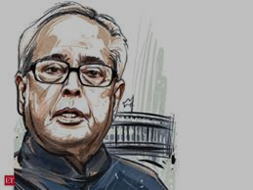
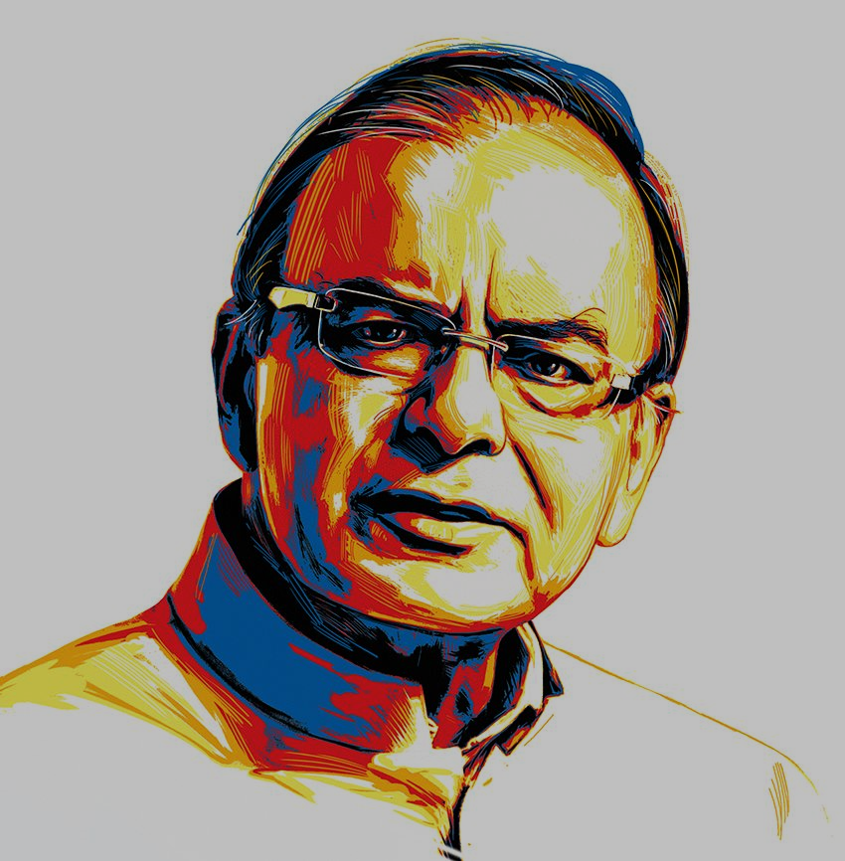
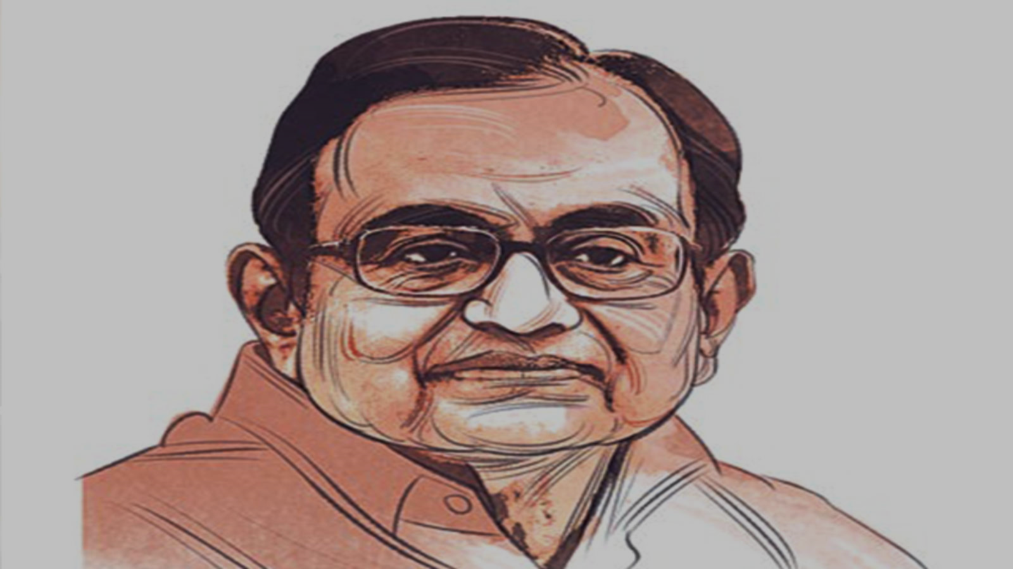
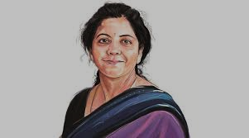
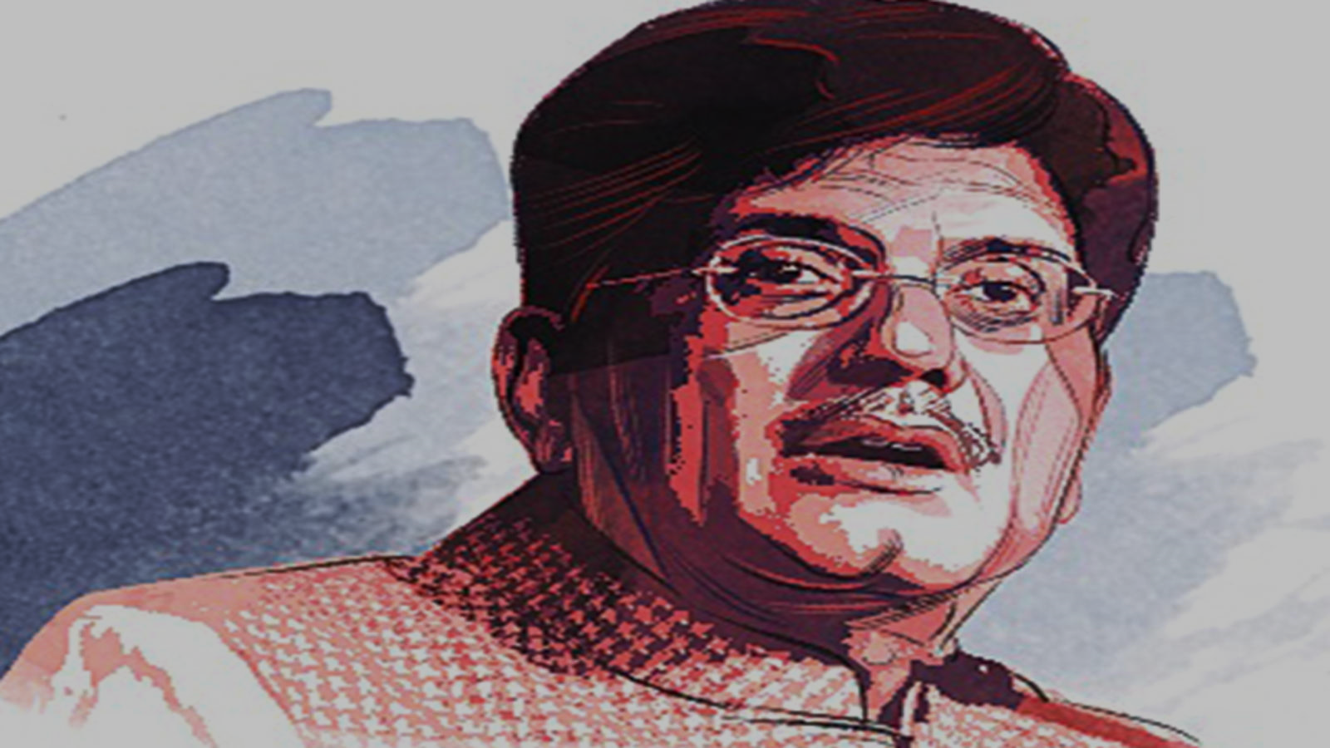
A Big Eye on Indian FMs’
An NLP based approach to Analyse Indian FMs’ and their promises
Submitted by: Group 8
Srinivas Gulla
Pradeep Kumar M
Anusha
Harsh Solanki
Aniruddh
Mentor: Abhirupa Lodh

Slide 2
Project Objective and Introduction to Dataset
What makes a Finance Minister ‘standout’?
An Experienced leader?
With a bold Underlying message?
The Optimistic one?
Result oriented?
The Economist?
Peoples’ leader?
The Challenger! ?
The Innovator ?
This project is an attempt to find out the answer through Budget Speeches and their promises

Slide 3
Contents
Project Objective and Introduction to Dataset
Data Understanding: - Data Pre-processing - Data Processing with EDA
Analysis on Lexicon Dictionary Coverage
Algorithm selection and coverage expansion
Sector wise Correlation with GDP 1. Topic Modeling 2. Custom Mapping
Classification – Prediction on 2020 Speech
Conclusion
Not in this presentation

Slide 4
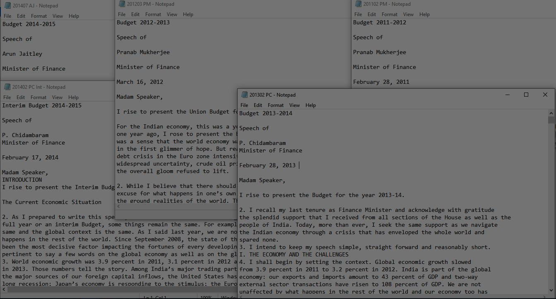
Project Objective and Introduction to Dataset
We’ve collated speeches of Finance Ministers from 2010 to 2019 in .txt files. We’ve also included interim speeches for the years’ 2014 and 2019

Slide 5
Project Lifecycle
Input
Data Cleaning
Data Pre-processing
12 .txt files of Budget Speech
Regular Expressions
Lexicon Packages
Lexicon Packages
Sentiment Analysis
Topic Modeling & Custom Mapping
Coverage Comparison and Expansion using custom dictionary
EDA
Correlation with GDP
Classification

Slide 6
Sector wise Correlation with GDP
We’ve followed two approaches in Correlating Sentiments of a speaker to the GDP (sector-wise)
1. Topic Modeling – LDA
Finding Top 8 relevant topics for a given sector from each speech
Mapping sentiment changes over years to the GDP for a given sector
2. Custom Mapping
Finding all relevant sentences for a given sector from each speech
Defining a ‘weighted sentiment’ to each sector and mapping it with GDP over years

Slide 7
1. Observations from Topic Modeling-Correlation
Pranab Mukherjee (2010-2012) | Sectors | Growth | Results
 | Manufacturing, | 34.52000941 | Mining & Agriculture
 | Agriculture | 43.53594685
 | Construction | 40.02734356
 | Mining | 50.97391352
P. Chidambaram(2013-2014 Q1) | Sectors | Growth | Results
 | Construction | 2.656338734 | Finance & Insurance
 | Finance & Insurance | 11.15307814
 | Social & Personal | 3.846807823
 | Mining | 0.189375445
Arun Jaitley(2014 Q2-2018) | Sectors | Growth | Results
 | Finance & Insurance | 9.968822573 | Finance & Insurance,Manufacturing
 | Manufacturing, | 9.717164949
 | Mining | 6.995967785
 | Agriculture | 3.082710088
Piyush Goyal(2019 Q1) | Sectors | Growth | Results
 | Finance & Insurance | 6.947285083 | Social Personal
 | Mining | 4.674278494
 | Social & Personal | 8.669492684
 | Manufacturing | 2.231101224
 | Hotel &Transport | 5.72661776
Nirmala Sitharaman (2019 Q234) | Sectors | Growth | Results
 | Manufacturing | -0.845703502 | Finance & Insurance +Ve and Manfacturing -ve
 | Finance & Insurance | 5.146570513

Slide 8
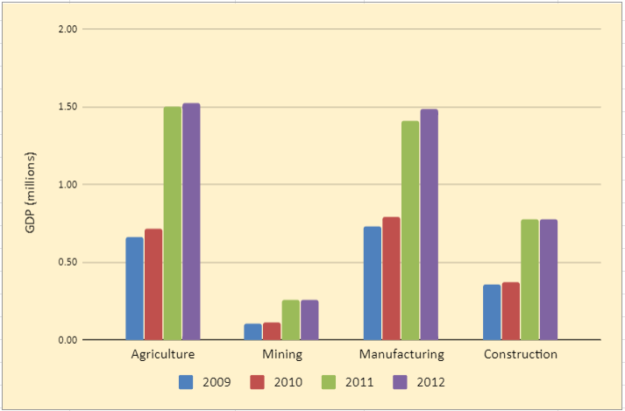
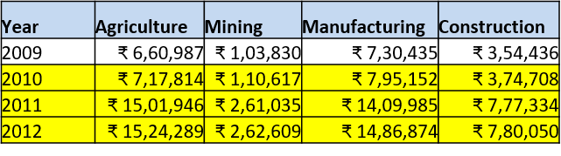
1. Observations from Topic Modeling-Correlation
From the topic modelling results ,we can see Pranab mukherje – speeches from 2010 to 2012 has mainly focused on Manufacturing, mining, construction and Agriculture sectors and the same got reflected very well in GDP results
There is a slight swift in GDP for all these sectors on his first year 2010, and it’s increased all most 100% in the next year 2011 on each sector and again observed slight swift in 2012.

Slide 9
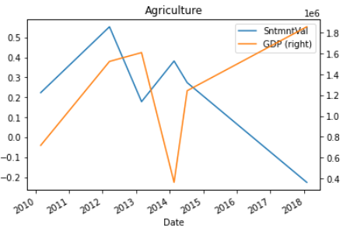
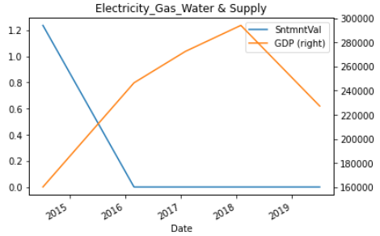
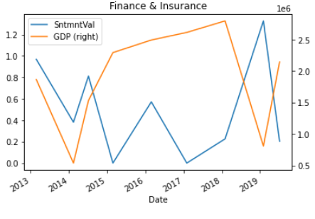
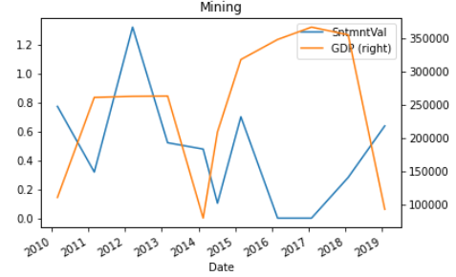
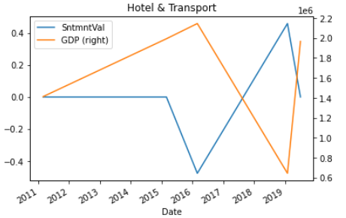
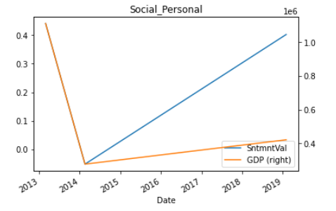
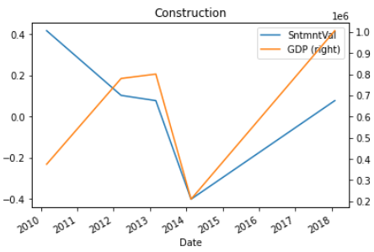
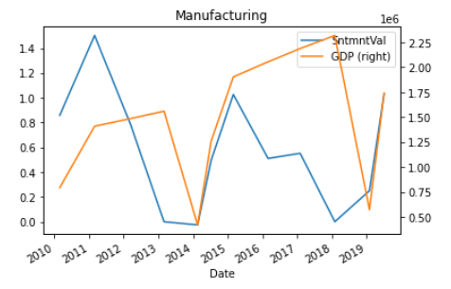
1. Observations from Topic Modeling-Correlation

Slide 10
1. Observations from Topic Modeling-Correlation
Pranab Mukherjee
Feb-26,2010 speech has Manufacturing, mining, construction and Agriculture
Feb-28,2011 speech has manufacturing , generic and mining
March-16,2012 speech has Mining , Manufacturing , Agriculture and construction
From 2010 to 2012 has concentrated more on Manufacturing, mining, construction and Agriculture and we can see to slight swift in 2010 for these sectors but same has been increased almost 100% for 2011 year and 2012 got the slight swift
Arun Jaitley
July-10,2014 speech has Electricity &water supply, finance & insurance , Manufacturing ,mining and agriculture
Feb-28,2015 speech has manufacturing and mining
Feb-29,2016 speech has generic , finance & insurance , Manufacturing and Hotel & Transport with the negative sentiment
Feb-1,2017 speech has manufacturing
Feb-1,2018 speech has mining, finance & insurance, construction and agriculture with negative sentiment
Arun Jaitley, from 2014 to 2018 has concentrated more on finance & insurance, manufacturing and mining and we can see consistent improvements for all these sectors except mining
P. Chidambaram
Feb-28,2013 speech has finance & insurance, mining, social personal, Agriculture and construction
Feb-17,2014 speech has Mining , finance & insurance, Agriculture, social personal ,Manufacturing and construction with the negative sentiment
From the results P. Chidambaram from 2013 to 2014 Q1 has concentrated more on finance & insurance, mining, social personal, Agriculture and construction and we can see consistent improvements for all these sectors
Piyush Goyal
Feb-1,2019 speech has finance & insurance, mining, Hotel & Transport ,social personal and Manufacturing
Nirmala Sitharaman
July-5,2019 speech has Manufacturing and finance & insurance

Slide 11
1. Observations from Topic Modeling-Correlation
Agriculture
We can see the positive relation between 2010 to 2012 And negative relation for the range 2013 to 2019,overall it’s negative
Construction
We can see the negative relation from 2010 to 2012 and positive relation between 2013 to 2019 , overall it’s a positive relation
Electricity_Gas_Water_Supply
We can see the negative relation from 2013 to 2016 and no relation between 2016 to 2019 , overall it’s a negative relation
Hotel_Transport
We can see no relation from 2011 to 2015 and no relation between 2015 to 2019 , overall it’s a negative relation
Manufacturing
We can see positive relation from 2011 to 2012 ,negative relation between 2011 to 2014 ,positive relation 2014 to 2015 ,-ve relation between 2015 to 2016 ,+ve relation between 2016 to 2017 ,2017 to 18 –ve and 2018 to 19 +ve,overall it’s a positive relation
Finance_Insurance
We can see + ve relation between 2013 to 2014 ,no relation between 2014 to 2017 ,+ve relation between 2017 to 2018 and -ve relation between 2018 to2019,overall it’s a - ve relation
Social_Personal
We can see positive relation between 2014 to 2019.

Slide 12
2. Observations from Custom Mapping-Correlation
Note that Speeches are delivered in early part of a year. However, GDP is calculated by the end of the year
Select relevant sentences corresponding to each sector for a given speech
Calculate Aggregated Sentiment Polarity of each sector for a given speech
Defining categories and areas under each sector
Define Scaled Sentiment values
Correlate with the GDP
Scaled Sentiment = Aggregate Sentiment / Number of such sentences

Slide 13
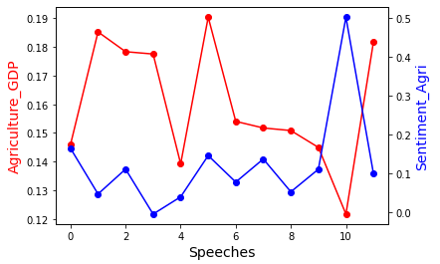
2. Observations from Custom Mapping-Correlation
Note that Speeches are delivered in early part of a year. However, GDP is calculated by the end of the year
For analysis purpose, consider Agriculture Sector and Speeches from 2010 to 2019
There is a response lag between GDP score and weighted Sentiment values. Hence do not consider the first segment(highlighted with a blue dotted line) of GDP and the last segment of sentiment
In 2014 BJP won and Arun Jaitley took over as FM, who over promised in July (as Sentiment value increased and GDP decreased)
In 2019 after Jaitley’s demise, Piyush Goyal overpromised in his speech
Other way to look at this would be:
For every transition in FM, Agriculture GDP takes a dip!
2010 2012 2014 Int 2015 2017 2019 int
Map the respective coloured arrows to find the pattern

Slide 14
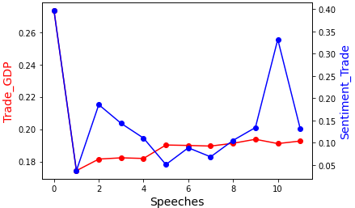
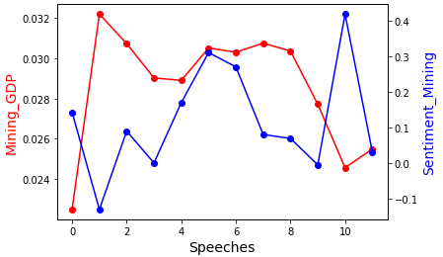
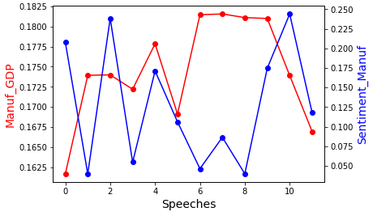
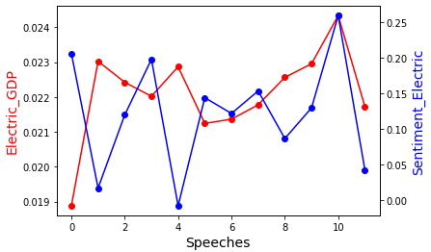
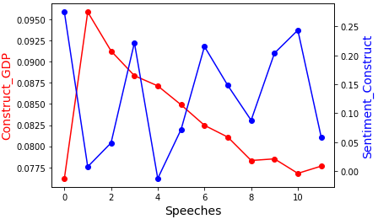
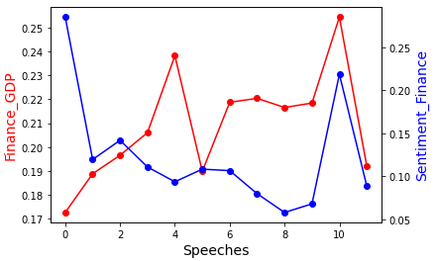
2. Observations from Custom Mapping-Correlation

Slide 15
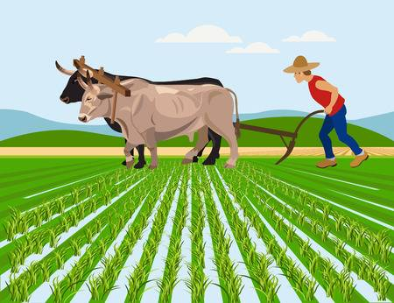
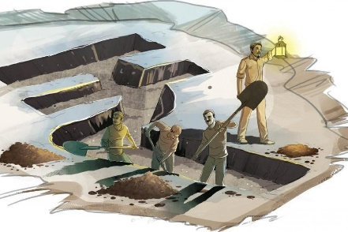

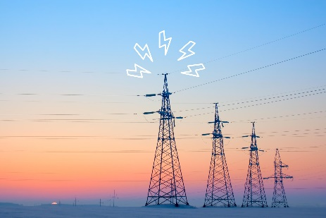
2. Observations from Custom Mapping-Correlation
Agriculture
Mining
Manufacturing
Utilities
1. Promising High :
Piyush Goyal
2. Promising Low:
P. Chithambaram
3. Best Performer
P. Chithambaram
4. Worst Performer
Pranab Mukharjee (2012)
1. Promising High :
Piyush Goyal
2. Promising Low:
Pranab Mukharjee
3. Best Performer
Piyush Goyal
4. Worst Performer
Arun Jaitley
1. Promising High :
Pranab Mukharjee
2. Promising Low:
Arun Jaitley
3. Best Performer
Arun Jaitley (2018)
4. Worst Performer
P. Chithambaram
(2014)
1. Promising High :
Piyush Goyal
2. Promising Low:
P. Chithambaram
3. Best Performer
Arun Jaitley
4. Worst Performer
P. Chithambaram
(2014)

Slide 16



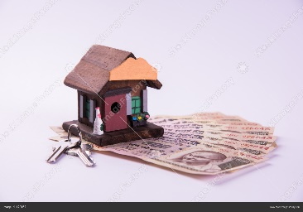
2. Observations from Custom Mapping-Correlation
Construction
Transport, Hotel, Hospitality
Real Estate
Social, Community
1. Promising High :
Pranab Mukharjee
2. Promising Low:
P. Chithambaram
3. Best Performer
Pranab Mukharjee
4. Worst Performer
P. Chithambaram
1. Promising High :
Pranab Mukharjee
2. Promising Low:
Arun Jaitley
3. Best Performer
Arun Jaitley
4. Worst Performer
Pranab Mukharjee
1. Promising High :
Pranab Mukharjee
2. Promising Low:
Arun Jaitley
3. Best Performer
Arun Jaitley
4. Worst Performer
P. Chithambaram
1. Promising High :
Pranab Mukharjee(2010)
2. Promising Low:
Pranab Mukharjee(2011)
3. Best Performer
Pranab Mukharjee
4. Worst Performer
Arun Jaitley

Slide 17
Classification – Traditional Algorithms
Building a Model that classifies recent 2020 Budget Speech
1. Naïve Bayes
Model Accuracy on Training : 0.841
Model F1 Score on Training : 0.836
Model F0.5 Score on Training: 0.837
Model Accuracy on Test : 0.768
Model F1 Score on Test : 0.781
Model F0.5 Score on Test : 0.795
2. Random Forest
Model Accuracy on Training : 0.934
Model F1 Score on Training : 0.9321
Model F0.5 Score on Training: 0.9329
Model Accuracy on Training : 0.904
Model F1 Score on Training : 0.907
Model F0.5 Score on Training: 0.913
3. XGBoost
Model Accuracy on Training : 0.851
Model F1 Score on Training : 0.841
Model F0.5 Score on Training: 0.850
Model Accuracy on Test : 0.782
Model F1 Score on Test : 0.789
Model F0.5 Score on Test : 0.818
3. LSTM
Model Accuracy: 0.928
Model F1 Score: 0.925

Slide 18
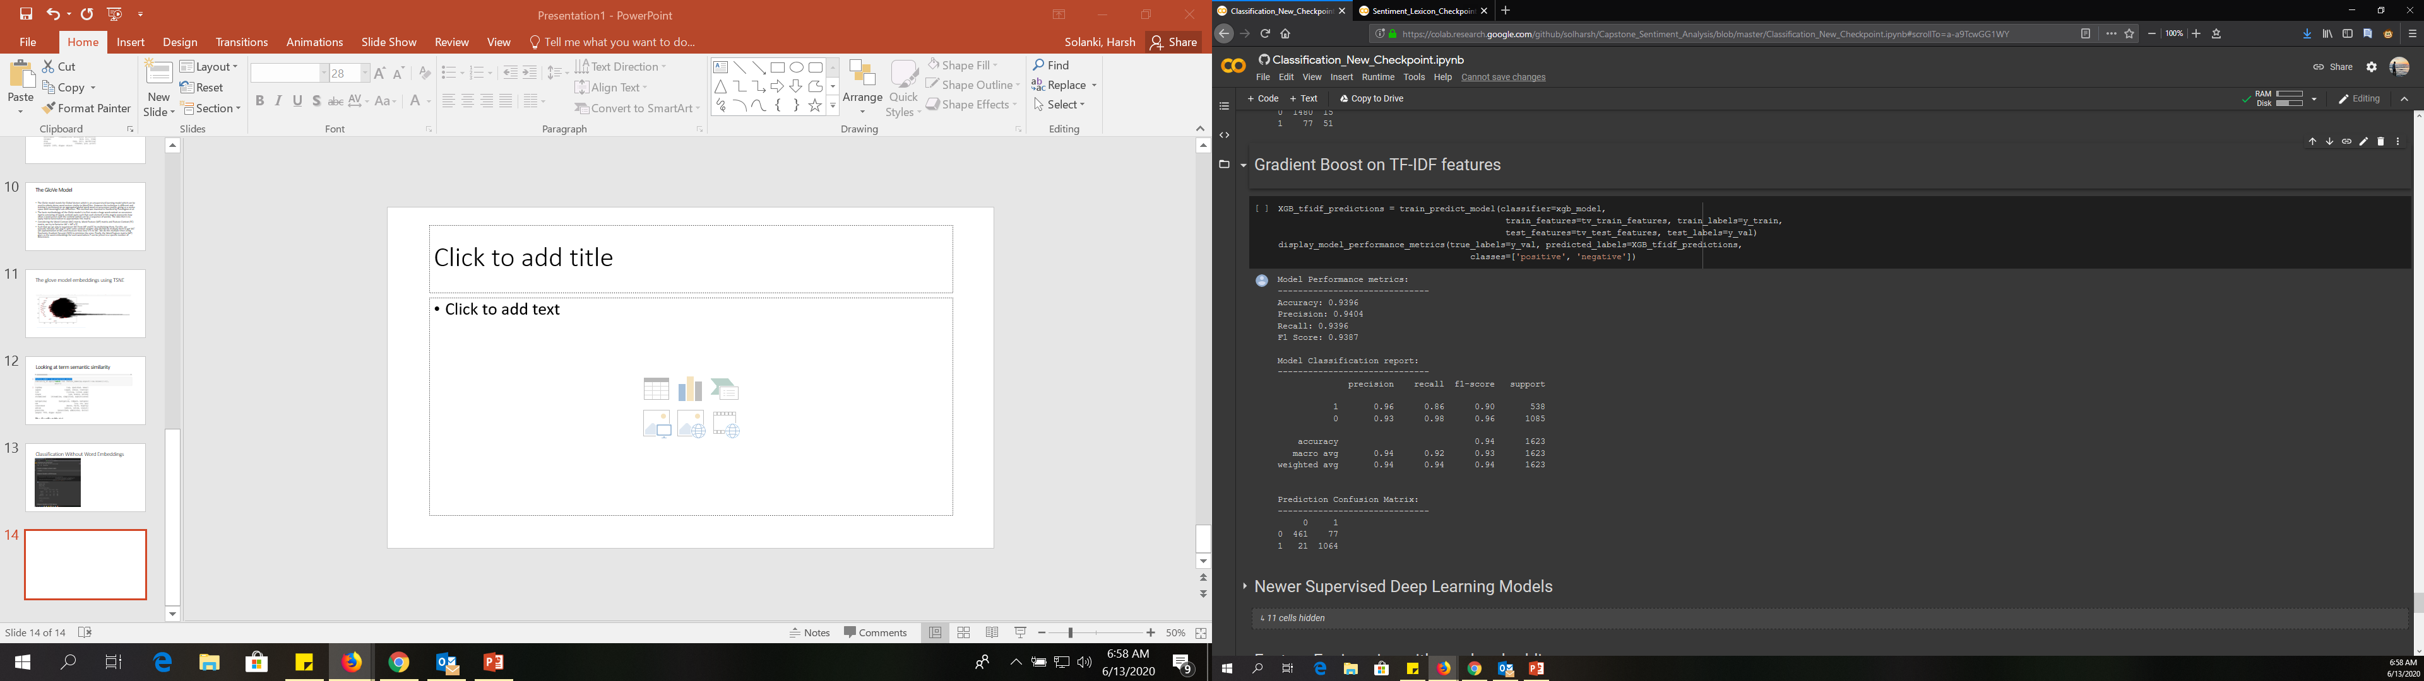
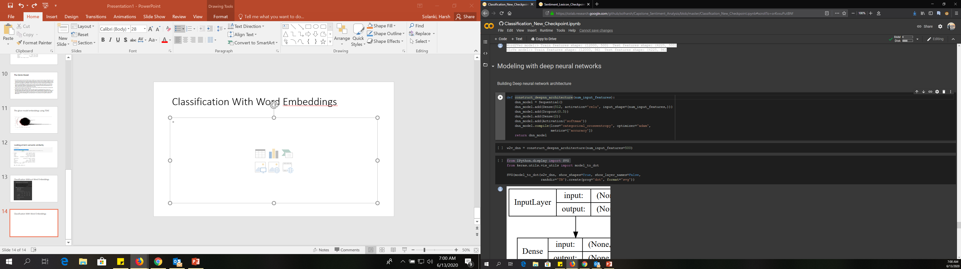
Classification Without Word Embedding
Classification With Word Embedding (word2Vec)

Slide 19
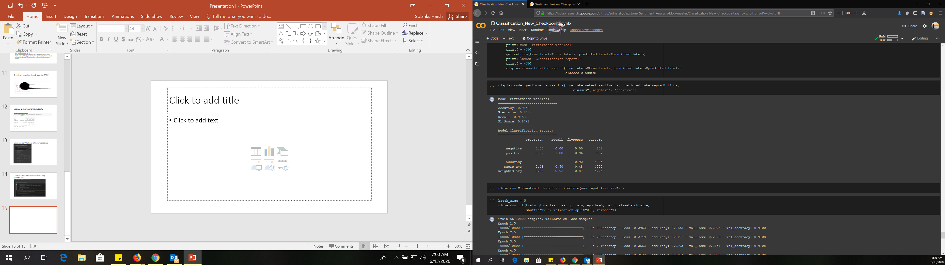
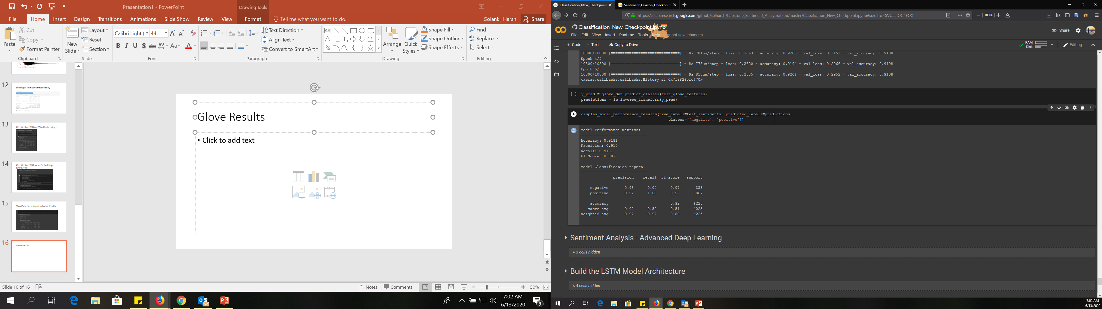
Word2vec Deep Neural Network Results
Glove Results (results are not good with word embeddings due to less number of training features)

Slide 20
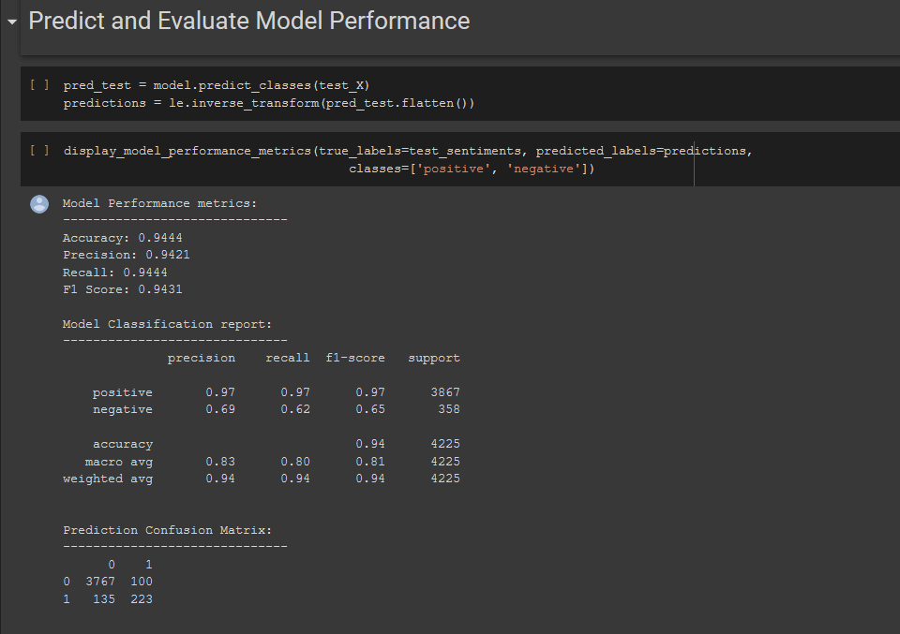
LSTM Results

Slide 21
Recommendations & Applications
Can be used by political entities in formulating the budget speeches
In understanding schemes/ initiatives specific to a sector : Failure/ Success
Election Campaigning
4. Planning investments/ business expansions based on budget promises
5. Understanding the lag between the speech and results : Gives a picture on ‘actability’

Slide 22
Future Scope
Though we have turned Hyper parameters for a few of the models, we could perform to all the other models as well
Adding more custom sentiment values to the finance/tax related terms
Text Summarization of each sector in a given year’s speech
Clustering words within the sectors to understand groups that constitutes them. This can also help us add a new word to their respective groups, thereby label a sentiment polarity value
Creating a package of this project that helps users to input a budget speech and get analysis to it

Slide 23
Thank you
Submitted by:
Srinivas Gulla
Pradeep Kumar M
Anusha
Harsh Solanki
Aniruddh
Mentor: Abhirupa Lodh

Slide 24
Additional Slides if required for explanation . . .

Slide 25
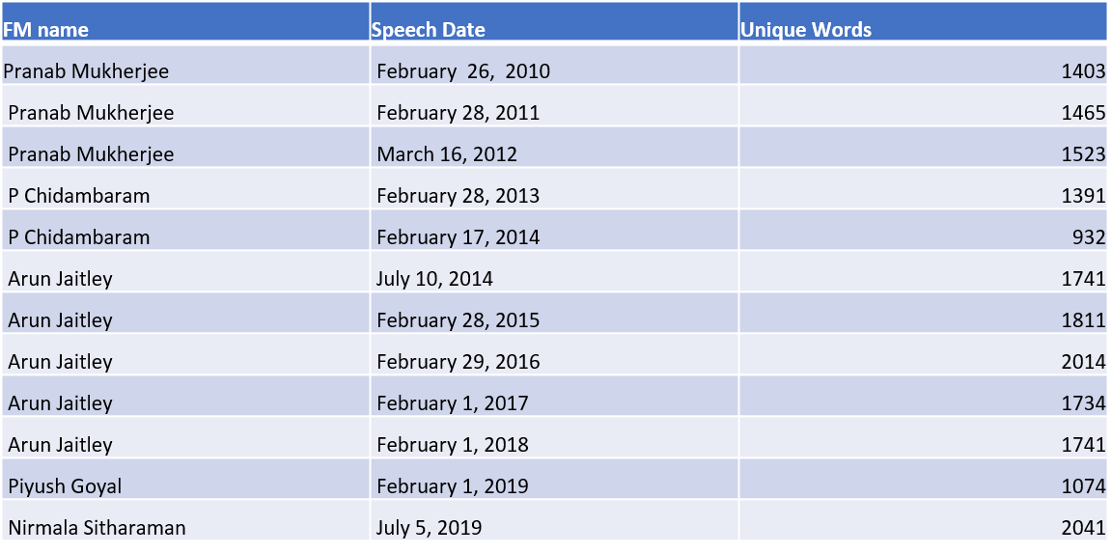
Data Understanding-Data Pre-processing
Unique tokens from each of the speeches

Slide 26
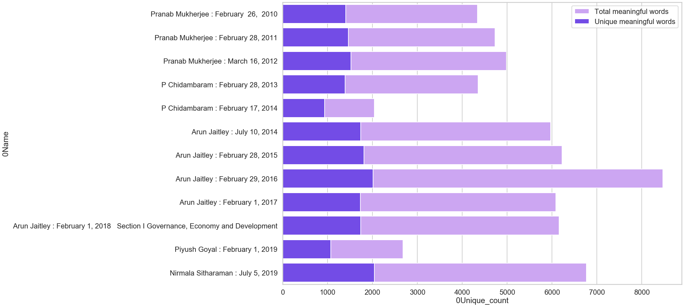
Data Understanding-Data Pre-processing
Considering Bag of Words (BOW) from each speech, here is a graph that indicates how many of the words are unique from all the words

Slide 27
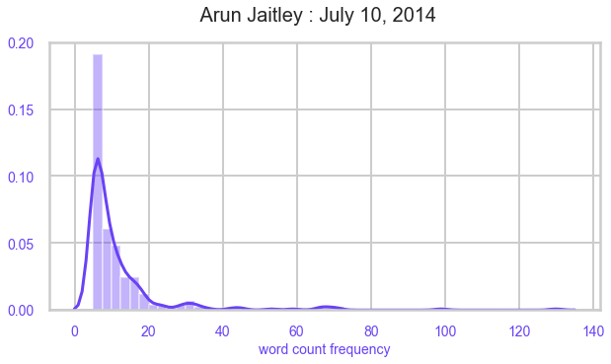
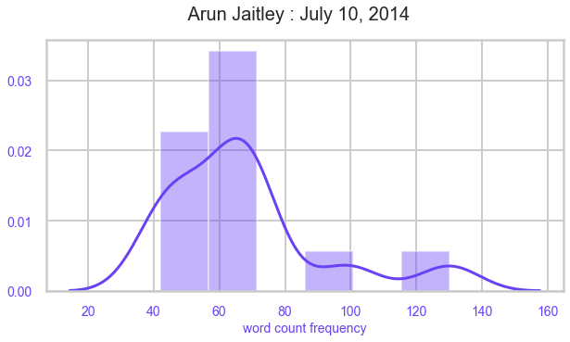
Data Understanding-Data Pre-processing
It is word frequency distribution of speech, We can observe that words with less frequencies are more in number indicating left skewed histogram as above
when we dive into distribution of words with higher frequencies it appears to be near normal distribution
This observation is common among all speeches
it indicates that all FM speeches use some set of common words which are having higher frequencies, commonly used words are shared by all FM speeches.

Slide 28
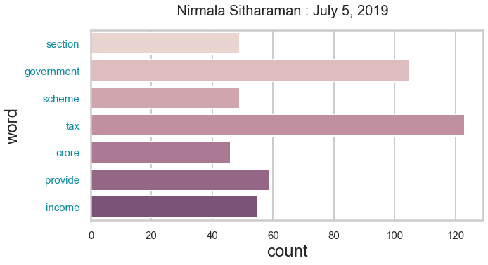
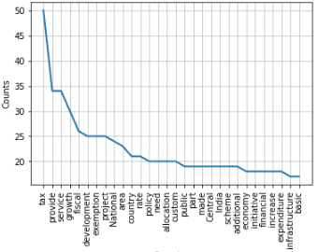
Data Understanding-Data Pre-processing
Here is a specific speech with its most occurring words and counts
Pranab Mukharjee : Feb, 2010

Slide 29
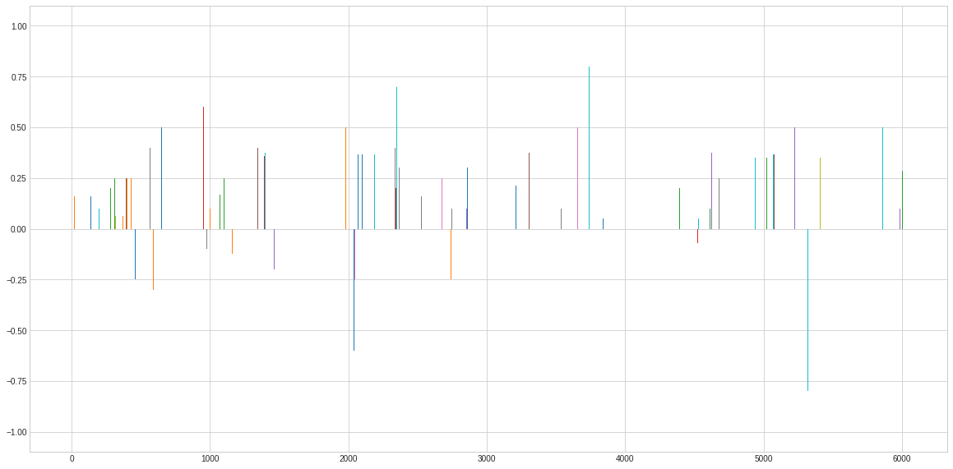
Analysis on Lexicon Dictionary Coverage
This is a representation of sentiment polarity of lexicon words found for the 2010 Pranab Mukharjee speech
As we can see, there are a lot of words with positive polarity over negative polarity

Slide 30
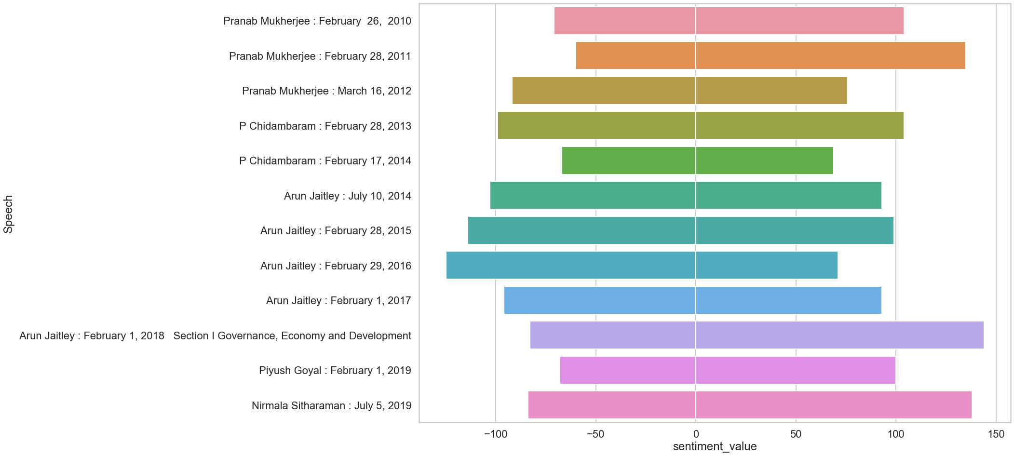
Algorithm selection and coverage expansion
We’ve seen VADER giving us the most coverage. Hence, we selected this algo and went ahead to see which are the most common words that have been assigned Zero Polarity. Considering the importance of words, we’ve given custom polarity to these words and tried re-running the model.
Coverage for Vader and AFINN Combined

Slide 31
Algorithm selection and coverage expansion
Coverage for AFINN

Slide 32
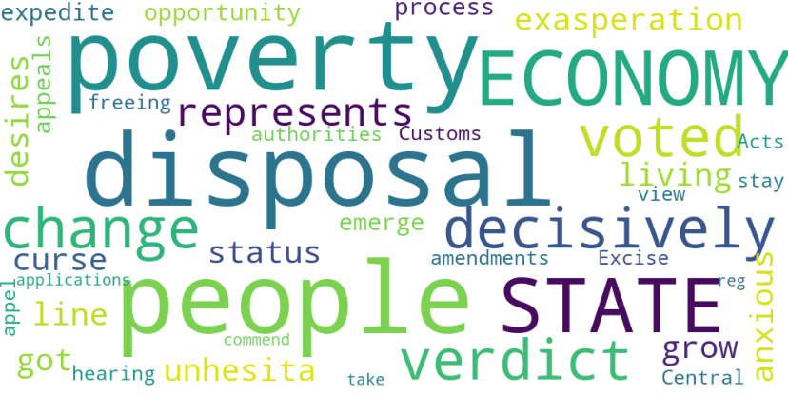
Data Understanding-Data Pre-processing
Word Cloud to Arun Jaitley’s July 10th 2014 Speech

Slide 33
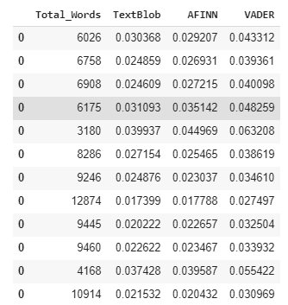
Analysis on Lexicon Dictionary Coverage
We’ve worked on Lexicon Dictionaries of Algos’ like TextBlob, AFINN, VADER
Here are the coverage values to each of the speeches
Nirmala Sitharaman speech had highest mean of 605.000000 positive words
P. Chidambaram speech had lowest mean of 301.500000 positive words
Nirmala Sitharaman speech had highest mean of 288 negative words
Piyush Goyal speech had lowest mean of 96 negative words

Slide 34
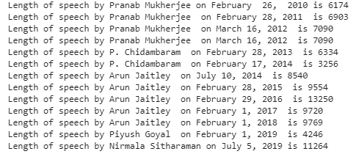
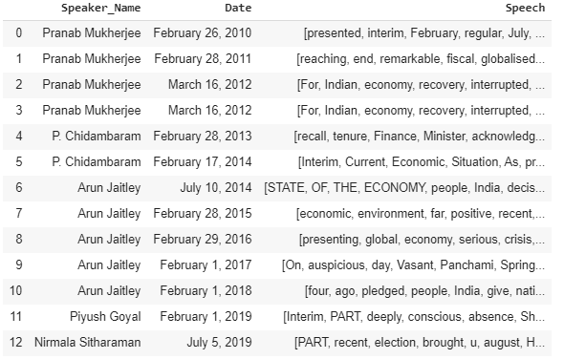
Data Understanding-Data Pre-processing
Created a DataFrame with ‘Speaker Name’, ‘Data’, ‘Speech’ columns
Length of each speech
Challenges:
Each .text file had a different formatting with a wide variety of uncleaned entities like ‘Hinglish words, website links, double space, special symbols, etc.
Stopwords identification suiting the business objective
Unlabelled Data
Solution to overcome:
Using regular expressions and simple tokenization methods, we could clean the data to a usable corpus
In addition to the lexicon stop words(used NLTK, VADER,AFINN), we have also added custom stop words based on its occurrence. We made sure to separate words with ‘not’ and excluded from the list

